Slide 1
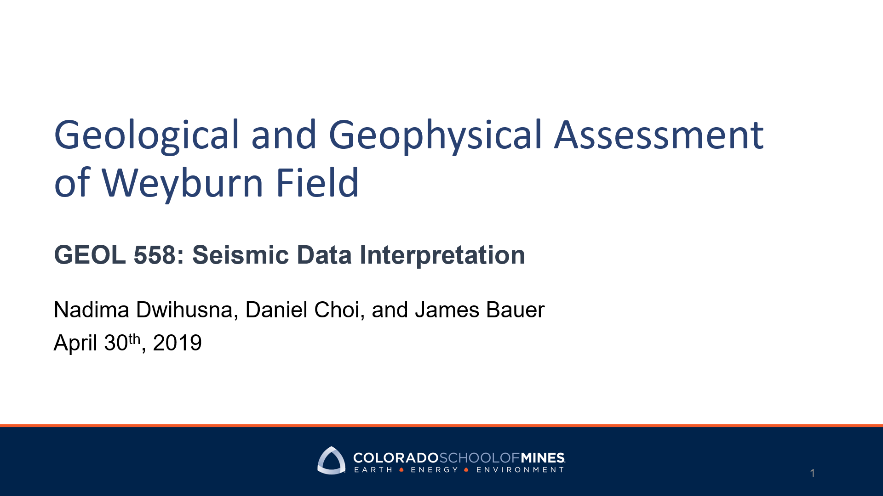
GPGN 558: Seismic Data Interpretation

Slide 2

Outline
Geological Background
Interpretation
Horizon Picking, Surface, and Isochron Maps
Attribute Maps
Vp/Vs, NRMS, and Gassmann Fluid Substitution
Target Area
Economic and Risk
Recommendation

Slide 3
Outline
Geological Background
Interpretation
Horizon Picking, Surface, and Isochron Maps
Attribute Maps
Vp/Vs, NRMS, and Gassmann Fluid Substitution
Target Area
Economic and Risk
Recommendation

Slide 4
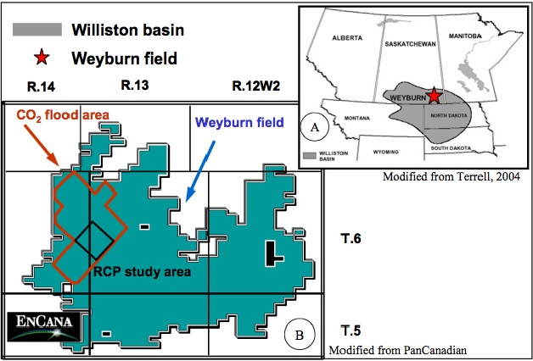
Location of Weyburn Field
(Royer, 2004)
Located in Williston Basin, Southeastern Saskatchewan
CO2 EOR Project to maximize recovery from carbonate reservoir: Midale Beds
Produced 335 million barrels of oil
Estimated 1.4 billion barrels OOIP

Slide 5
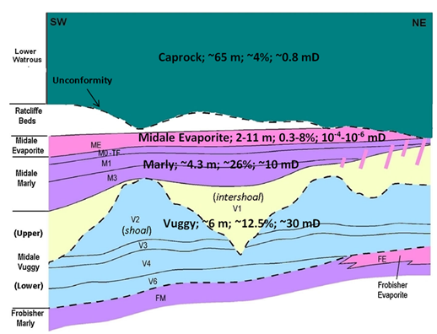
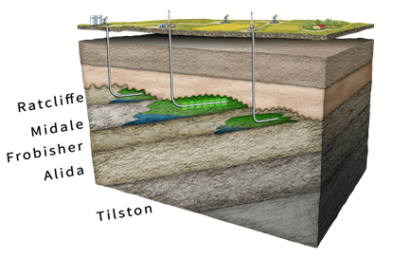
Generalized Cross Section of Weyburn Reservoir
(Geotech Geol Eng, 2017)

Slide 6
Generalized Cross Section of Weyburn Reservoir
(Geotech Geol Eng, 2017)
Midale carbonate reservoirs contain 2 distinct zones at depth approximately 1450 m
Marly
Permeability 10 md
Porosity 26%
Thickness 7-10 m
Vuggy
Permeability 15 md
Porosity 11%
Thickness 5-20 m

Slide 7
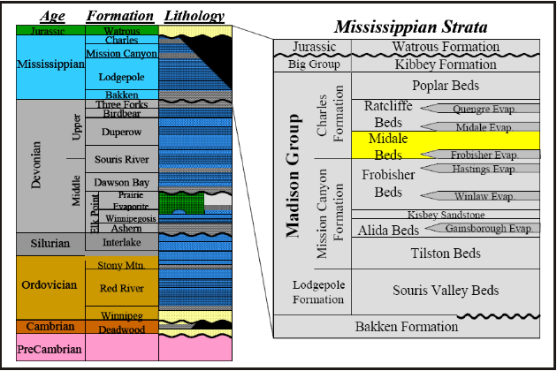
Stratigraphic Column Showing Midale Bed
(Royer, 2004)

Slide 8
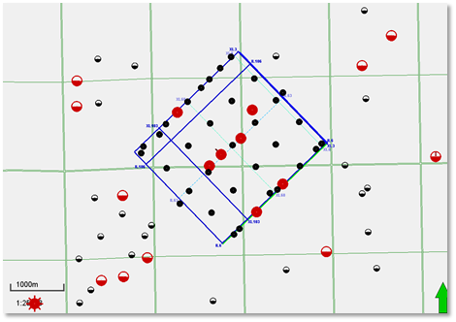
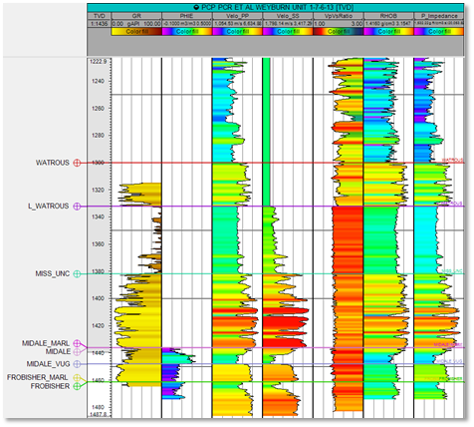
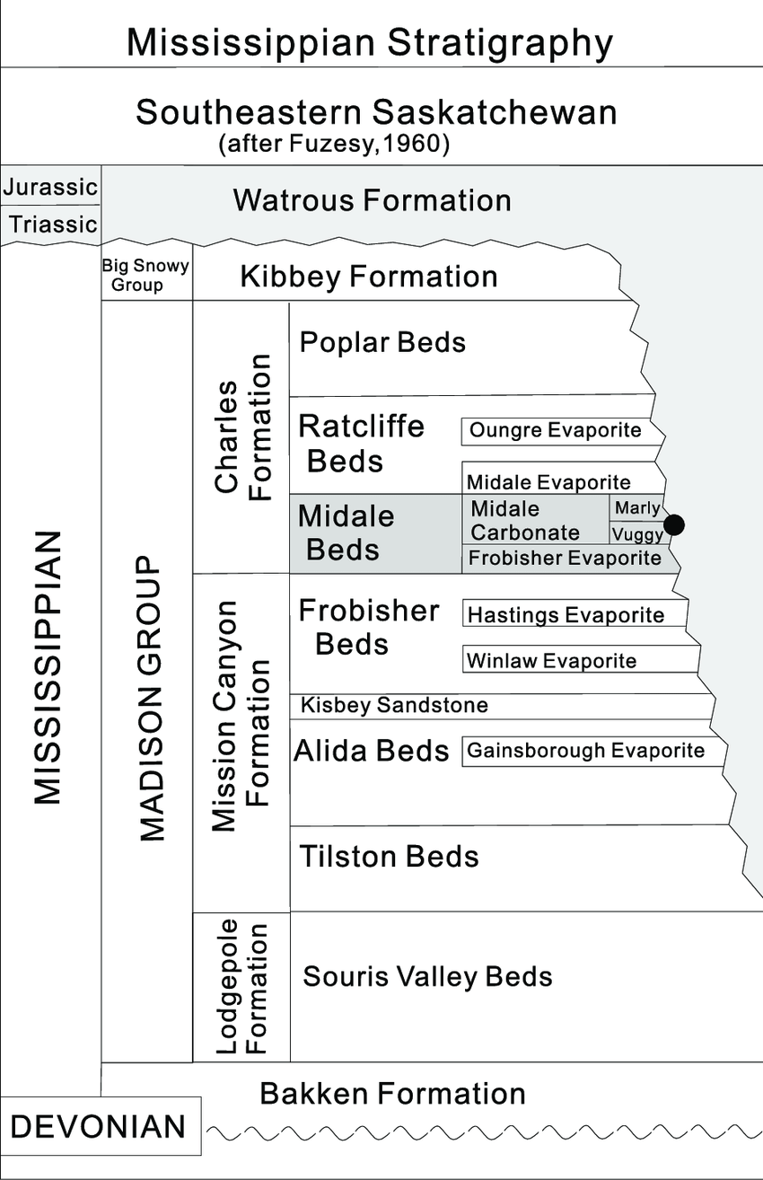
Midale Marly and Vuggy Reservoir
Mississippian Unc.
Evaporites
Marly
Vuggy
Frobisher Beds
(Researchgate.net)

Slide 9
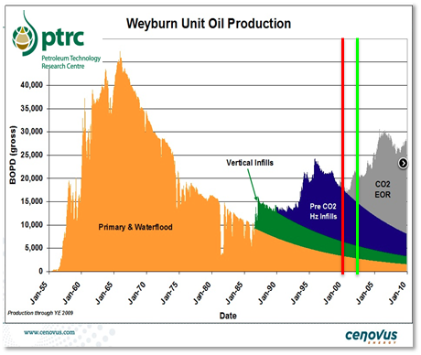
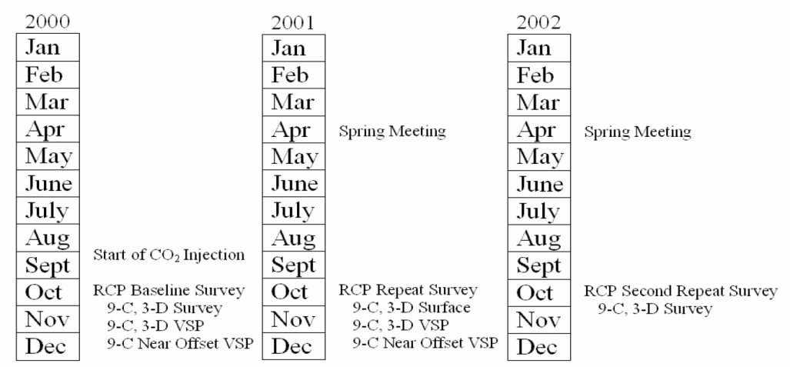
CO2 EOR Project to Maximize Recovery
(Petroleum Technology Research Center, 2019)
Phase VIII Reservoir Characterization Project Fall 2002 Report
Notes:
Map of RCP 9-C Survey (orange) with area of minimum 80 fold for P-waves (blue) and minimum 100 fold for S-waves (purple). The PanCanadian survey area leased by RCP is outlined in green and the well location of both the RCP and PCP VSP’s is indicated.

Slide 10
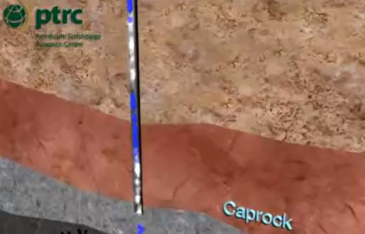
CO2 Infiltration in Marly and Vuggy
(Petroleum Technology Research Center, 2019)

Slide 11
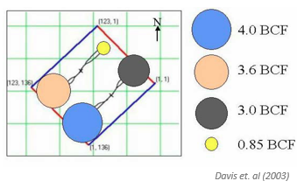
Cumulative Injection Rate Upto August 2002

Slide 12
Outline
Geological Background
Interpretation
Horizon Picking, Surface, and Isochron Maps
Attribute Maps
Vp/Vs, NRMS, and Gassmann Fluid Substitution
Target Area
Economic and Risk
Recommendation

Slide 13
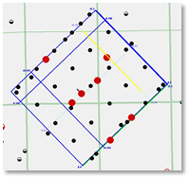
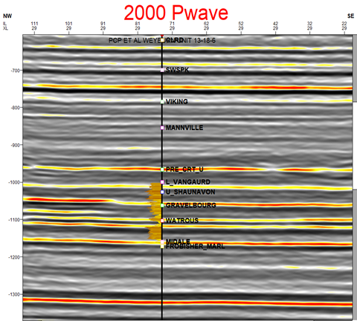
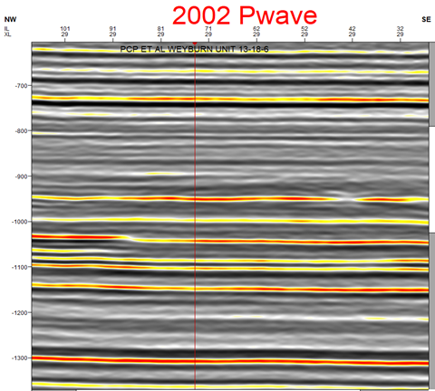

2002 P wave
2000 P wave

Slide 14
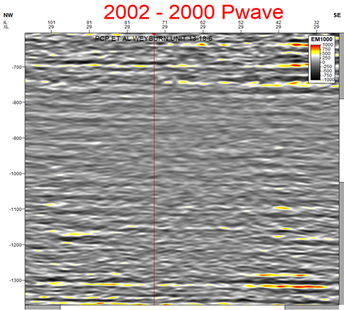
2002 - 2000 P wave

Slide 15
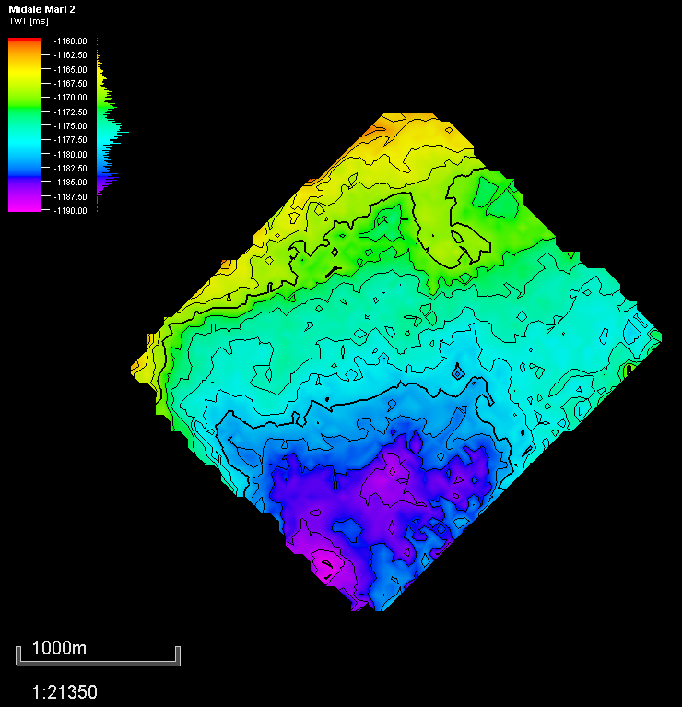
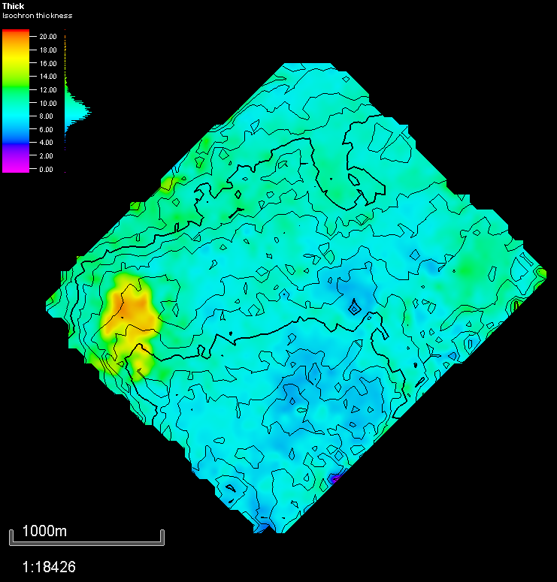
2002 Isochron
2002 Time Horizon

Slide 16
Outline
Geological Background
Interpretation
Horizon Picking, Surface, and Isochron Maps
Attribute Maps
Vp/Vs, NRMS, and Gassmann Fluid Substitution
Target Area
Economic and Risk
Recommendation

Slide 17
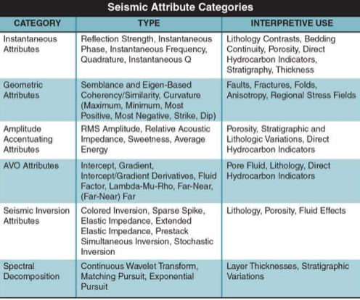
Instantaneous and Geometric Attribute

Slide 18
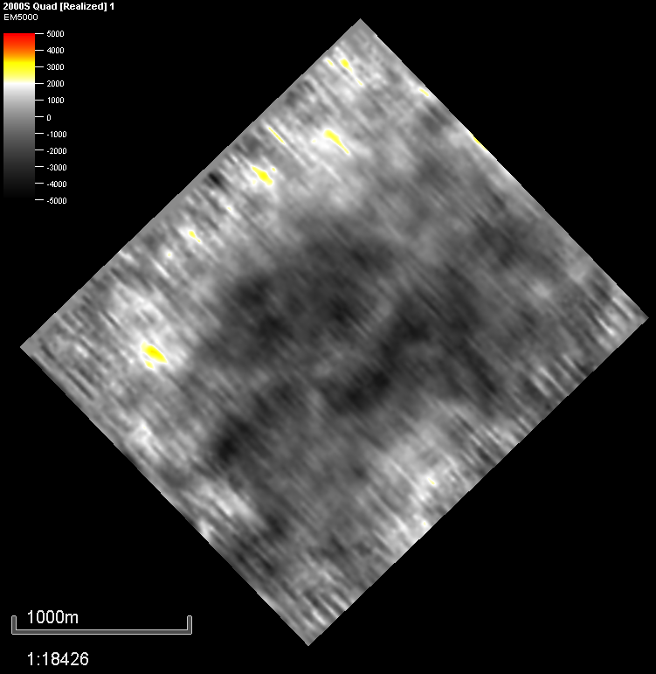
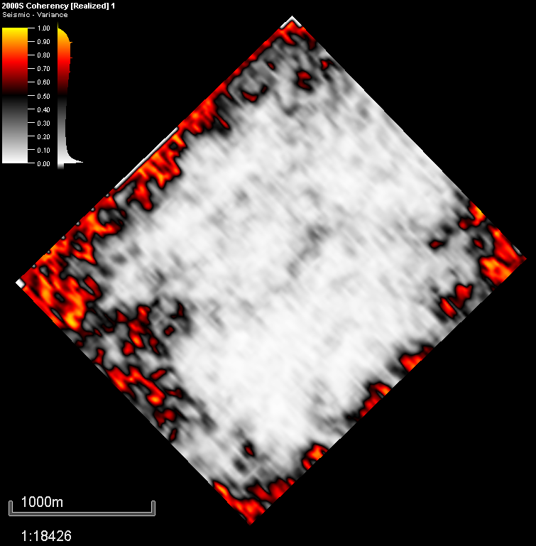
2000 S Quadrature 2000 S Coherency

Slide 19
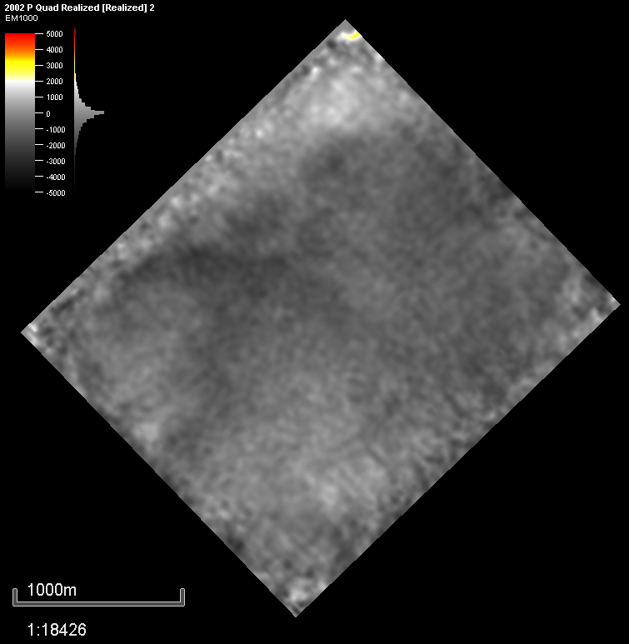
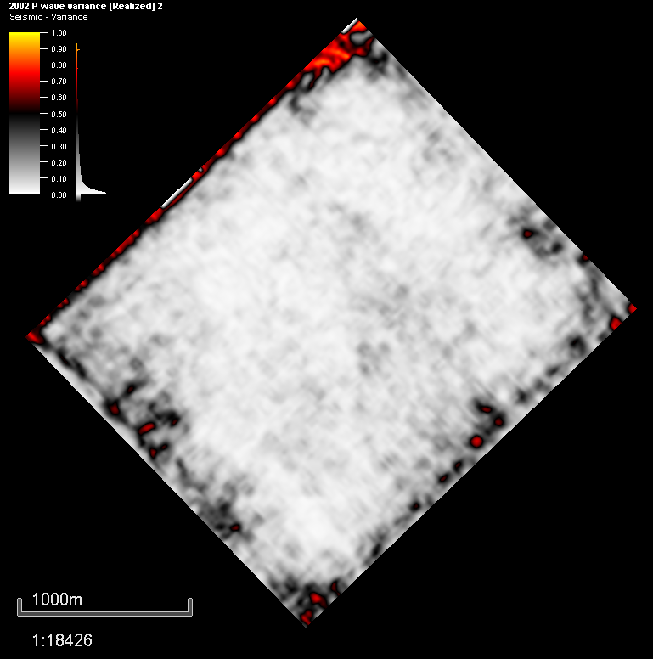
2002 P Quadrature 2002 P Coherency

Slide 20
RMS Accentuating Attribute

Slide 21
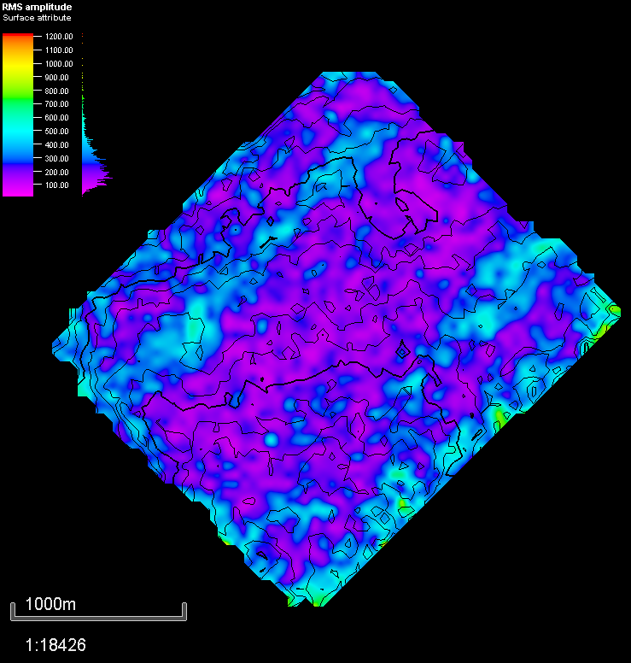
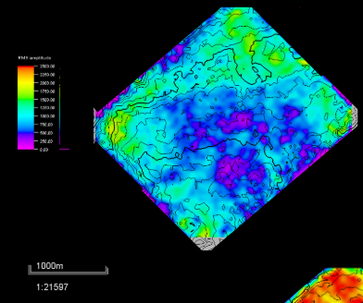
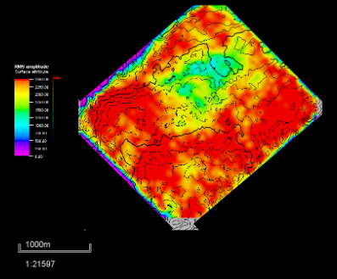
2000 - 2002 RMS Difference
2002 RMS
2000 RMS

Slide 22
2000 - 2002 RMS Difference
Changes in Reservoir
Changes in Reservoir

Slide 23
Outline
Geological Background
Interpretation
Horizon Picking, Surface, and Isochron Maps
Attribute Maps
Vp/Vs, NRMS, and Gassmann Fluid Substitution
Target Area
Economic and Risk
Recommendation

Slide 24
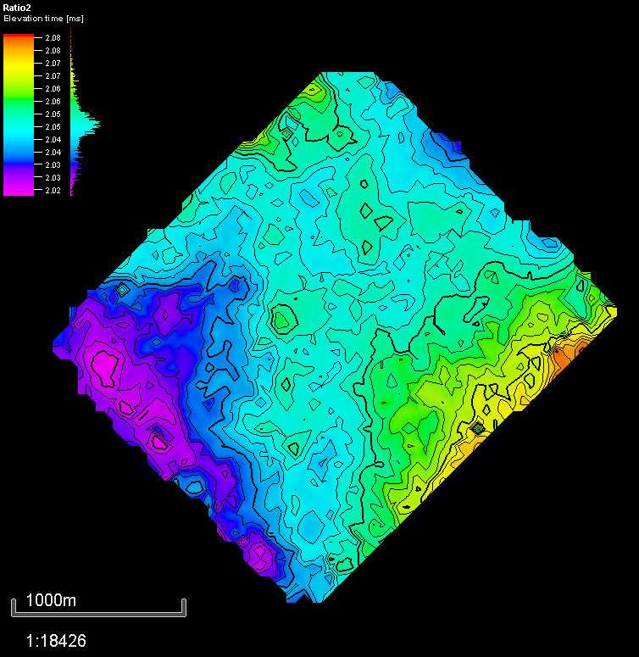
VP/VS Ratio
Notes:
Since 2000 year… the area still has constant hydrocarbon...no CO2 injections… cahnges may be because of lithology rather than fluids

Slide 25
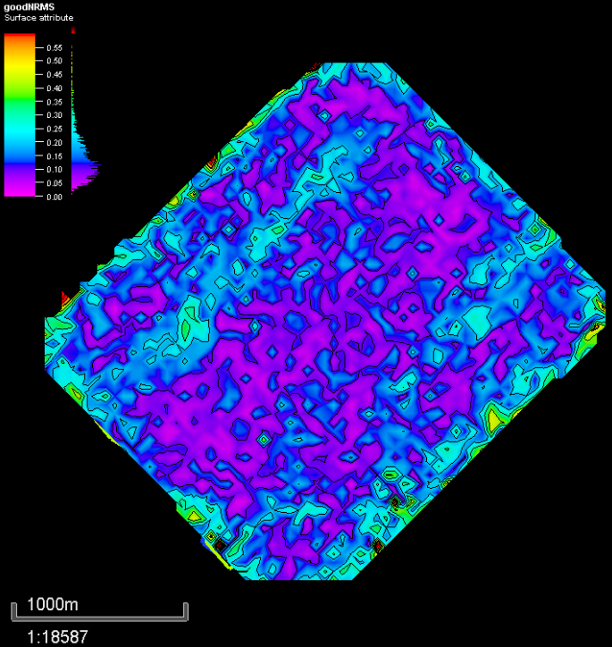
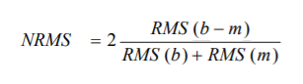
NRMS in Reservoir
Notes:
Add equation and explanation

Slide 26
NRMS in Reservoir
Changes in Reservoir
Little change
Notes:
Add equation and explanation

Slide 27
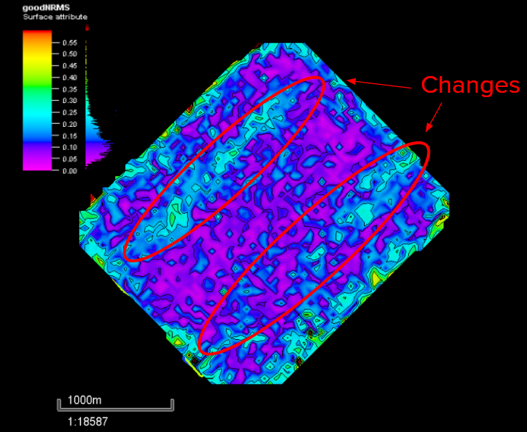
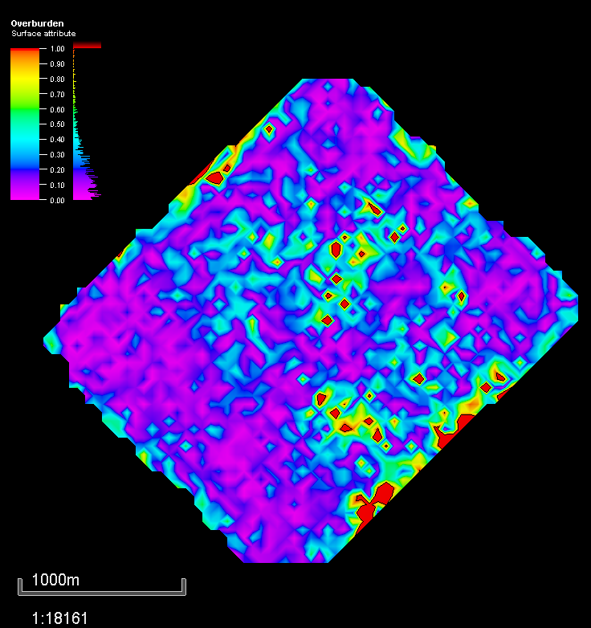
NRMS in Reservoir Vs. NRMS in Overburden

Slide 28
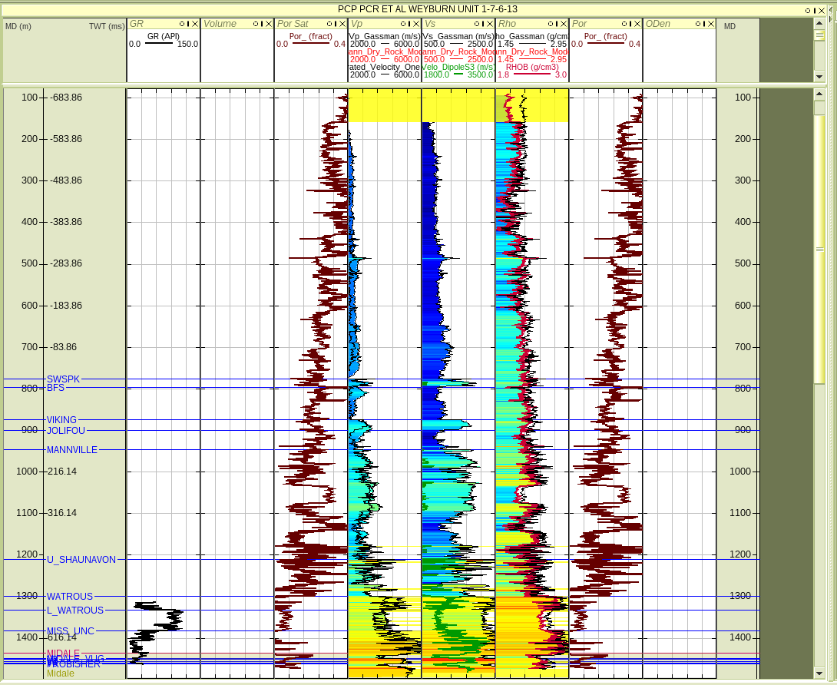
Gassmann Fluid Substitution
Midale Beds

Slide 29
Gassmann Fluid Substitution
Mississippian
Unc.
Marly
Vuggy
Frobisher
Beds
Midale Beds

Slide 30
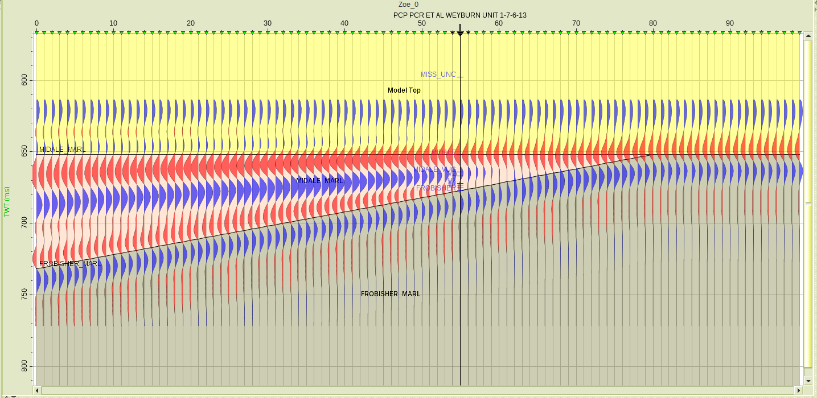
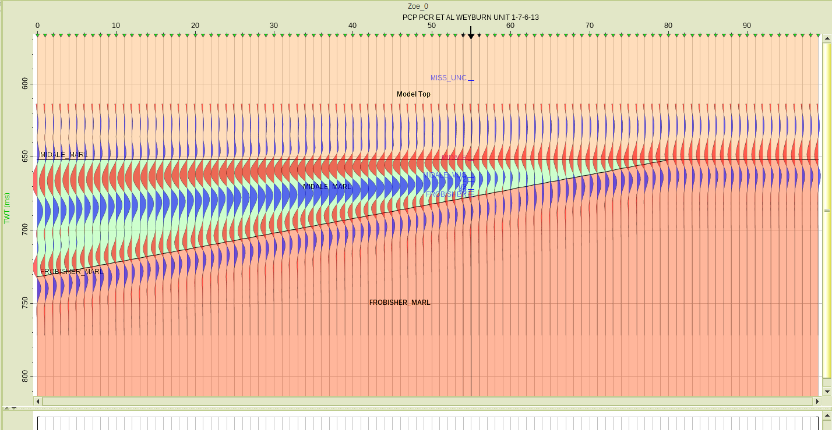
Gassmann Fluid Substitution
Original Wedge Model Gassmann Wedge Model

Slide 31
Outline
Geological Background
Interpretation
Horizon Picking, Surface, and Isochron Maps
Attribute Maps
Vp/Vs, NRMS, and Gassmann Fluid Substitution
Target Area
Economic and Risk
Recommendation

Slide 32
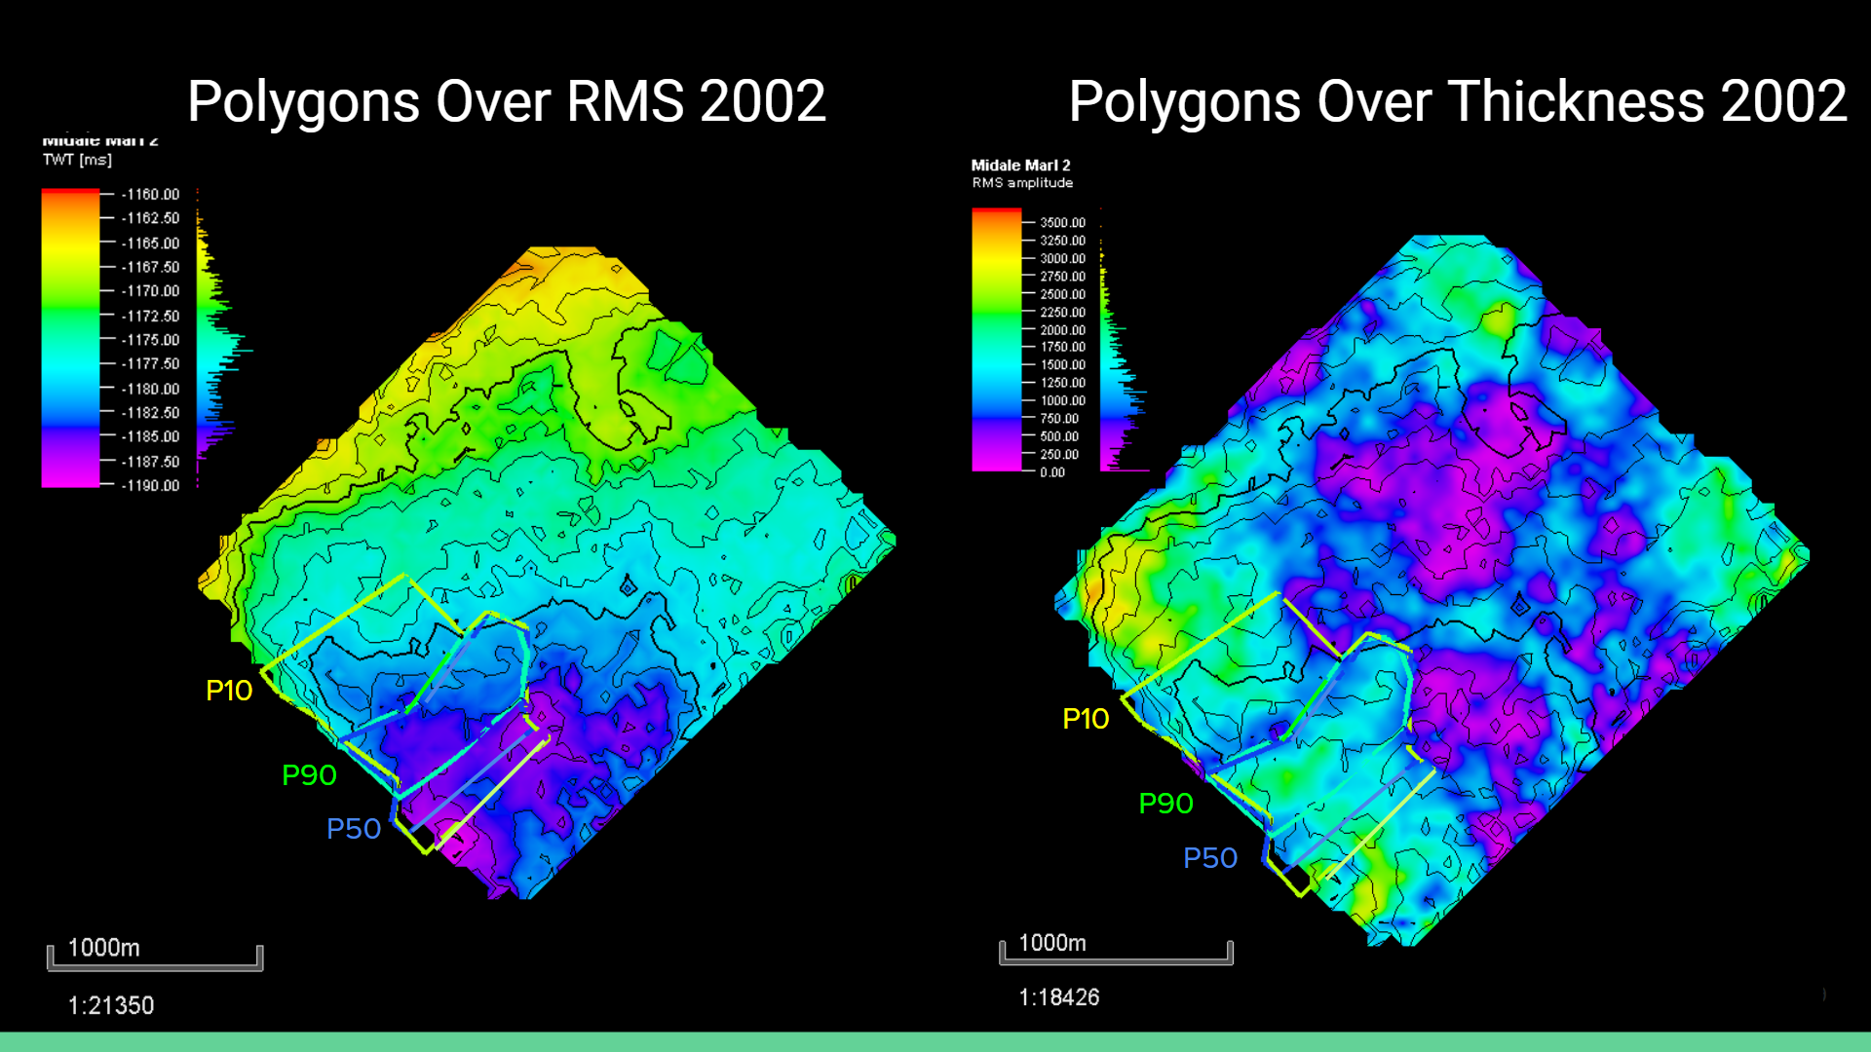
Notes:
JB starts.

Slide 33
Outline
Geological Background
Interpretation
Horizon Picking, Surface, and Isochron Maps
Attribute Maps
Vp/Vs, NRMS, and Gassmann Fluid Substitution
Target Area
Economic and Risk
Recommendation

Slide 34
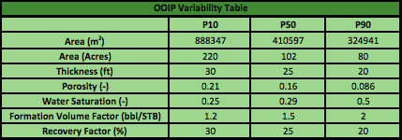

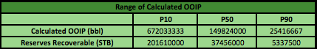
Economics

Slide 35
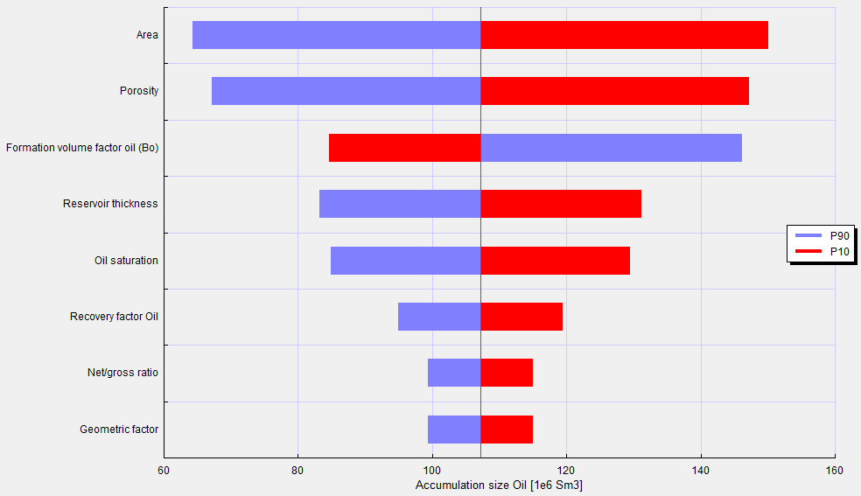
Tornado Diagram from GeoX
Area
Porosity
Formation Volume Factor
Reservoir Thickness
Oil Saturation
Recovery Factor Oil
Net/Gross Ratio
Geometric Factor
Accumulation Size Oil [1e6 Sm3]

Slide 36
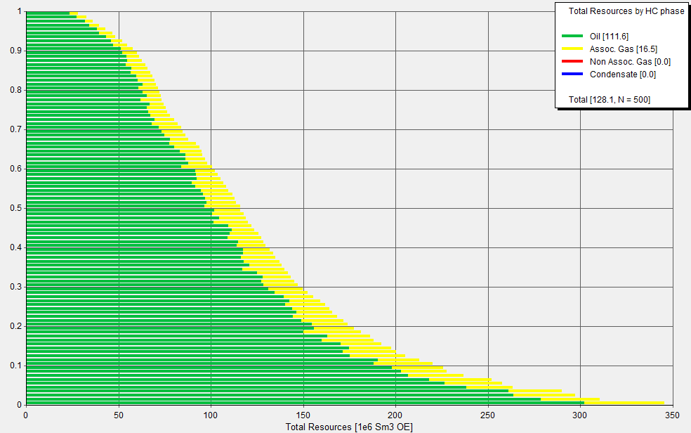
Resource Diagram from GeoX

Slide 37
Outline
Geological Background
Interpretation
Horizon Picking, Surface, and Isochron Maps
Attribute Maps
Vp/Vs, NRMS, and Gassmann Fluid Substitution
Target Area
Economic and Risk
Recommendation

Slide 38
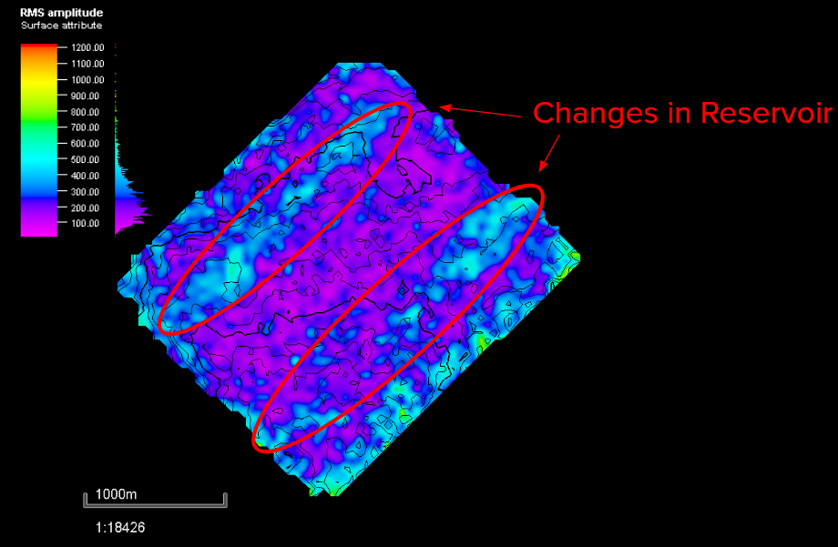
Recommendation
Low change (Hydrocarbon still present)

Slide 39
Recommendation
P10 - 12.8 billion dollars, 201 million barrels
P50 - 2.4 billion dollars, 37 million barrels
P90 - 340 million dollars, 5 million barrels

Slide 40
Recommendation
P10 - 12.8 billion dollars, 201 million barrels
P50 - 2.4 billion dollars, 37 million barrels
P90 - 340 million dollars, 5 million barrels
Notes:
ADD

Slide 41
References
[1] GPGN 558: Seismic Interpretation Lecture Notes
[2] “Overview of Seismic Interpretation.” Robbie Gries: A Career of Many 'Firsts' -
AAPG Explorer April 2012,archives.aapg.org/slide_resources/schroeder/9/index.cfm.

